Slide 1

IMAGE CAPTIONING WITH ATTENTION
Name: Gannoju Rohith
Branch: 4th year, CSE-3
Roll No: 18261A05E4
Mentor: Mr.M.Srikanth Sagar

Slide 2
Abstract:
Image Captioning is one of the emerging topics of research in the field of AI.
It is most important concept in artificial intelligence applied in the fields like aid to the blind, self-driving cars, and many more.
Image captioning needs to identify objects in image, actions, their relationship and some silent feature that may be missing in the image.
It involves the dual techniques from computer vision to understand the content of the image and a language model from the field of natural language processing to turn the understanding of the image into words in the right order.

Slide 3
Problem Definition:
The problem introduces a captioning task, which requires a computer vision system to both localize and describe salient regions in images in natural language.
For a caption model it not only need to find which objects are contained in the image and also need to be able to expressing their relationships in a natural language such as English.
It involves the dual techniques from computer vision to understand the content of the image and a language model from the field of natural language processing to turn the understanding of the image into words in the right order.
Flickr 8k dataset is used for training and testing purposes.
Prerequisites : Python,IDE(Jupyter),Flickr 8k,VGG16.

Slide 4
Existing system:
Existing techniques are all IOT based and they didn’t give the general solution.
Attention mechanism is not involved in existing image caption generator..
The existing systems have been using machine learning and IOT which results in very low accuracy.
Proposed system:
The proposed system would be a real time system wherein live images would be processed using attention mechanism.
Attention mechanism highlights the important and relevant parts of an image, in which those relevant parts can be used to generate words.

Slide 5
Base papers:
A. Hani, N. Tagougui and M. Kherallah, "Image Caption Generation Using A Deep Architecture," 2019 International Arab Conference on Information Technology (ACIT), 2019, pp. 246-251, doi: 10.1109/ACIT47987.2019.8990998.
H. Sharma, M. Agrahari, S. K. Singh, M. Firoj and R. K. Mishra, "Image Captioning: A Comprehensive Survey," 2020 International Conference on Power Electronics & IoT Applications in Renewable Energy and its Control (PARC), 2020, pp. 325-328, doi: 10.1109/PARC49193.2020.236619.

Slide 6
LITERATURE SURVEY:
S.No | Year Of Published | Title | Technology/ Algorithm used | Advantages | Disadvantages
1 | 2020 | Image Captioning: A Comprehensive Survey | CNN, LSTM,IOT,NLP | Using LSTM and CNN is far more better than using IOT. | Accuracy is less.
2 | 2020 | Automatic Image Captioning Technique | Hybrid Engine | Hybrid engine utilizes the combination of ”Speed Up Robust Algorithm”(SURF) with minimum eigen value to notice and classify objects. Then passed to a Content Free Grammar (CFG) to create grammatically meaningful phrases. | Automatic image captioning using neural networks is more advance and accurate method.
3 | 2020 | Automated image captioning | Inception v3 model. | Good performance on small datasets. | Less computing power, more time taking while training.
4 | 2019 | Image Caption Generation Using A Deep Architecture | Inception v3 model and LSTM | It uses less number of parameters and uses ADAM optimizer for good accuracy with faster rate of convergence. | Less accurate when dealing with large data sets
5 | 2018 | Convolutional Image Captioning | LSTM with attention, convolutional approach | Adding attention to LSTM increased the accuracy of prediction.. | Very low accuracy compared to the existing system.

Slide 7
References:
H. Sharma, M. Agrahari, S. K. Singh, M. Firoj and R. K. Mishra, "Image Captioning: A Comprehensive Survey," 2020 International Conference on Power Electronics & IoT Applications in Renewable Energy and its Control (PARC), 2020, pp. 325-328, doi: 10.1109/PARC49193.2020.236619.
K. C. Nithya and V. V. Kumar, " Automatic Image Captioning Technique," 2020 International Conference on Communication and Signal Processing (ICCSP), 2020, pp. 0432-0437, doi: 10.1109/ICCSP48568.2020.9182105.
A. Puscasiu, A. Fanca, D. Gota and H. Valean, "Automated image captioning," 2020 IEEE International Conference on Automation, Quality and Testing, Robotics (AQTR), 2020, pp. 1-6, doi: 10.1109/AQTR49680.2020.9129930.
A. Hani, N. Tagougui and M. Kherallah, "Image Caption Generation Using A Deep Architecture," 2019 International Arab Conference on Information Technology (ACIT), 2019, pp. 246-251, doi: 10.1109/ACIT47987.2019.8990998.
J. Aneja, A. Deshpande and A. G. Schwing, "Convolutional Image Captioning," 2018 IEEE/CVF Conference on Computer Vision and Pattern Recognition, 2018, pp. 5561-5570, doi: 10.1109/CVPR.2018.00583.

Slide 8
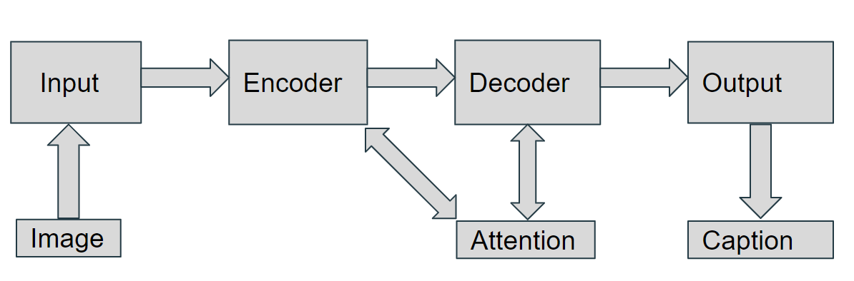
DESIGN AND METHODOLOGY:
System Architecture Diagram:

Slide 9
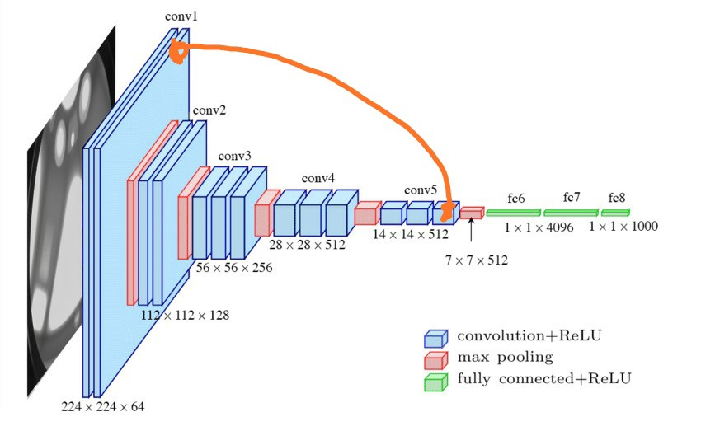
Encoder:
VGG16 Architecture:

Slide 10
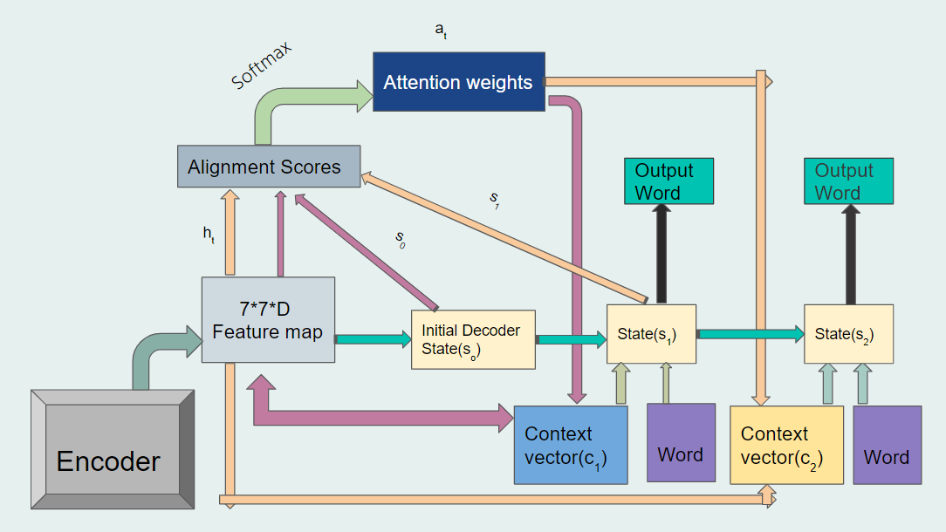
Model Architecture

Slide 11
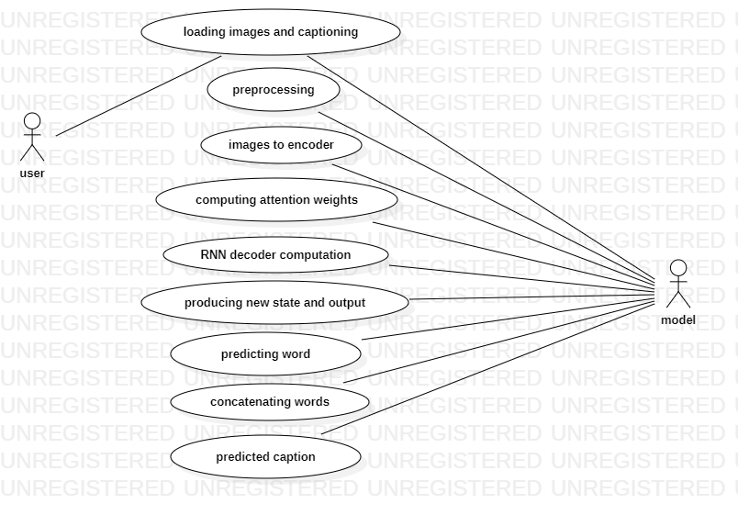
Use case Diagram

Slide 12
Thank You.

